Slide 1
Material Sensing based on mm-Wave Propagation and Reflection Maysoor Amin & Yashasvi Asthana

Slide 2
Applications
Portable Security system with low energy requirement
Visual Aid to blind people
Understanding material specific properties without heavy sensors

Slide 3
Hypothesis
It is feasible to sense material using RF signals without utilizing expensive infrastructure.
We can accurately identify different materials based on only the reflections (bouncing off) of signals from objects.

Slide 4
Why Millimeter Wave?
Power Efficient.
High Sensitivity in propagation loss, hence the loss is more expressive in shorter travel distances.
Mm-Wave is used in 5g which is being adopted worldwide, especially in smartphones.

Slide 5

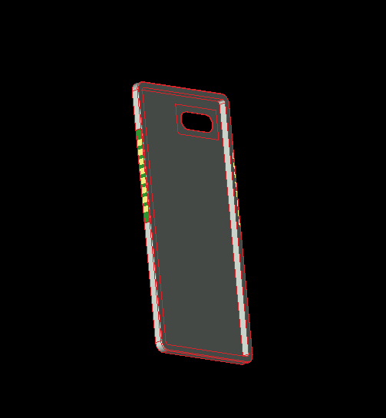
5G Antenna
The antenna array was designed on XFDTD-3D then imported to Wireless Insite to run simulations.
The design has 16 total sensors.
The antenna frequency was set at 28 GHz for our simulation.
We limit our study with one set of array being the transmitter and the other being the receiver.
1.0: 5G antenna design on a phone case

Slide 6
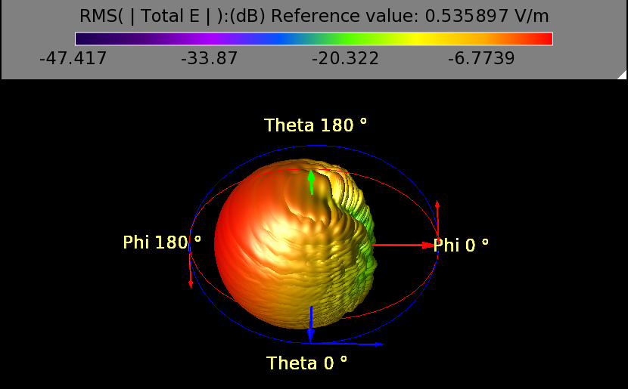
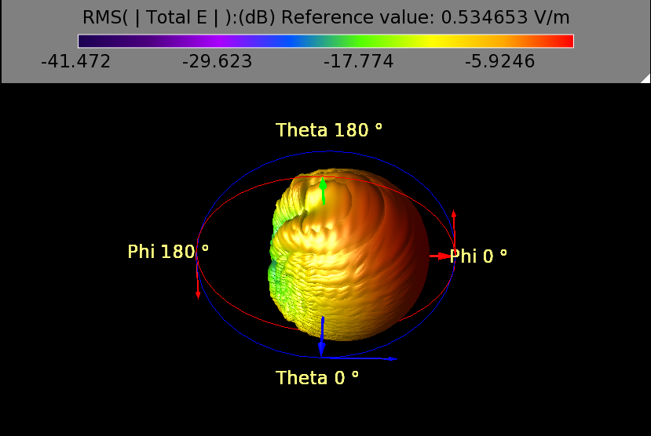
Electric-Field
1.1: Receiver E-Field
1.2: Transmitter E-Field

Slide 7
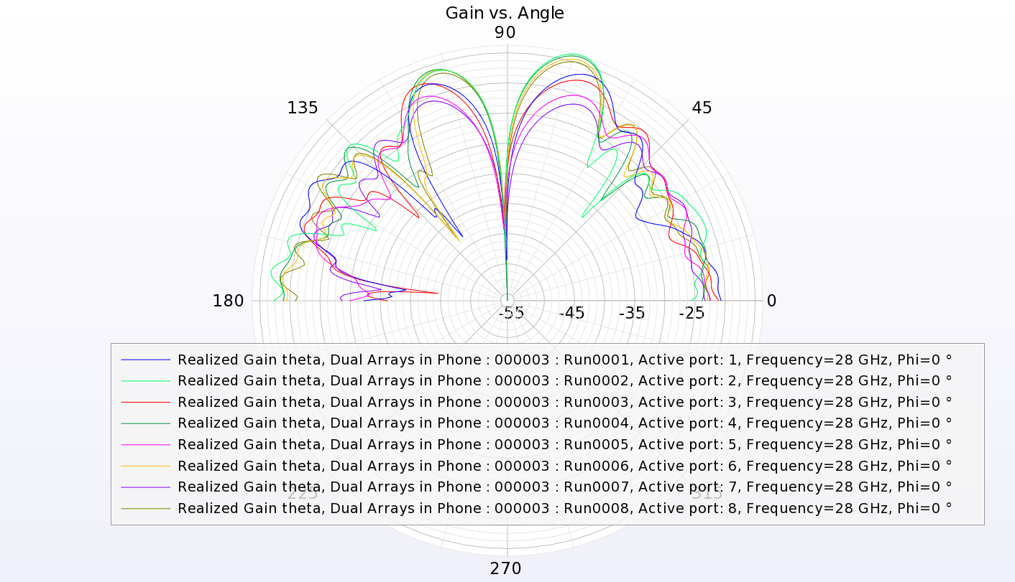
Transmitter Gain Profile

Slide 8
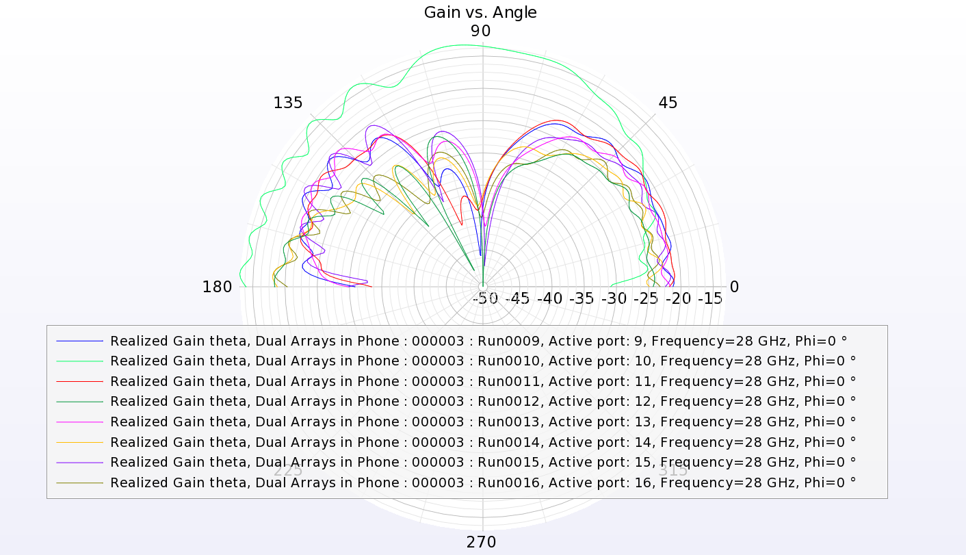
Receiver Gain Profile

Slide 9
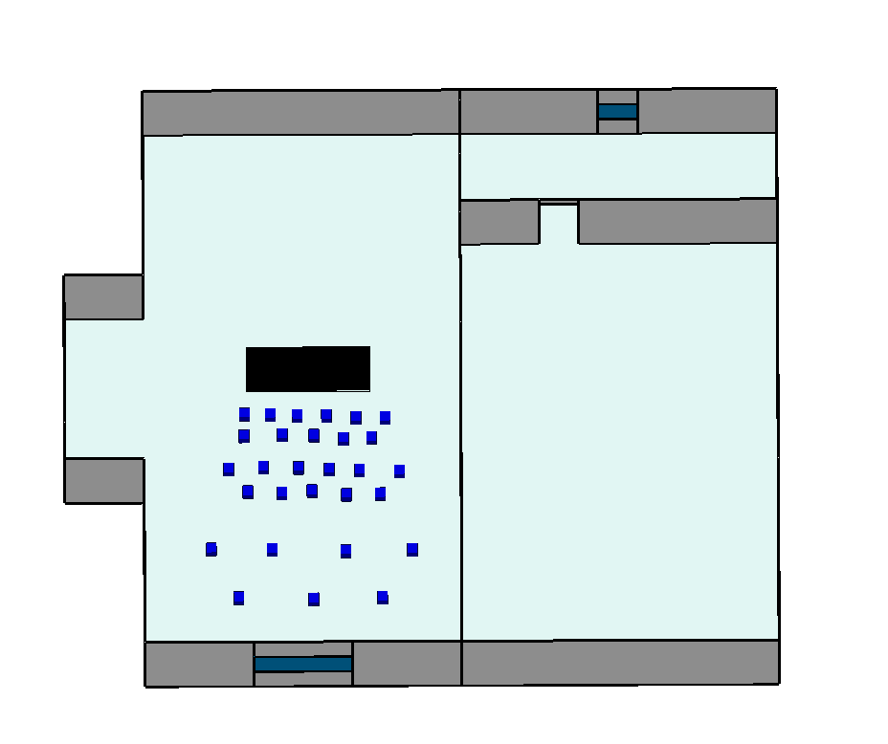
Wireless Insite Simulation
Regular office space.
Flat 3 cm thick sheet of the testing material placed in center.
Materials tested - GLASS, WOOD, METAL, CONCRETE, and PLASTIC
Blue points represent the positions of the individual Transceivers used in testing.

Slide 10
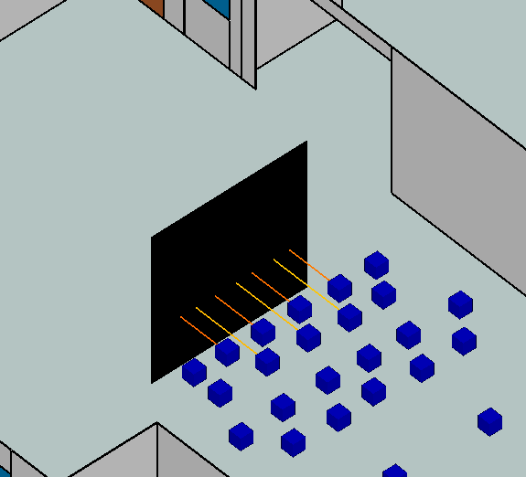
Wireless Insite Simulation
Simulations were run with 2 reflections, 2 transmissions and 1 diffraction allowed.
Multipaths were eliminated using the angle of arrival and the time-of-flight.
Every transmission to other transceivers were neglected to form the dataset.

Slide 11
Parameters
Phase Value
Time of Flight
Power Received
Angle of Departure (theta)
Angle of Departure (phi)
Angle of Arrival (theta)
Angle of Arrival (phi)
Distance Travelled (calculated using the ToF)

Slide 12
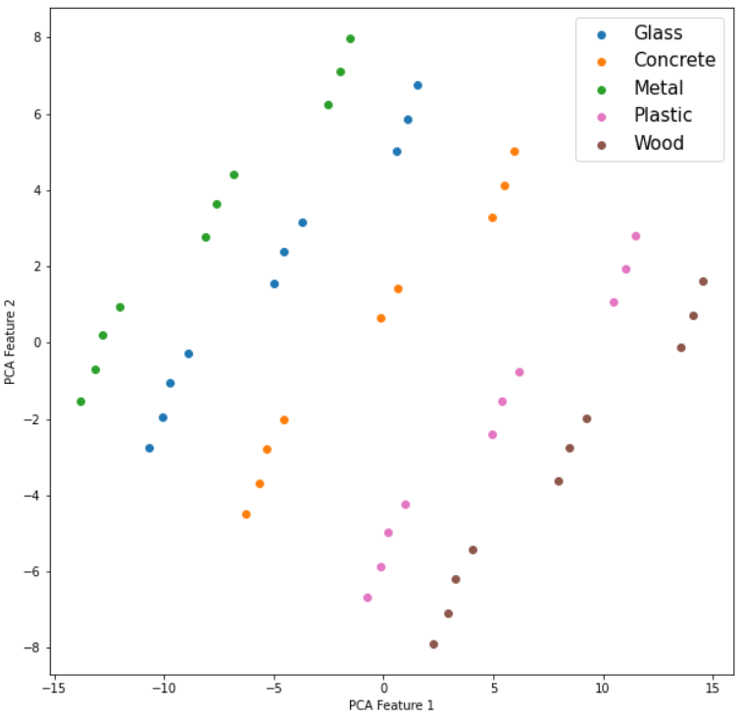
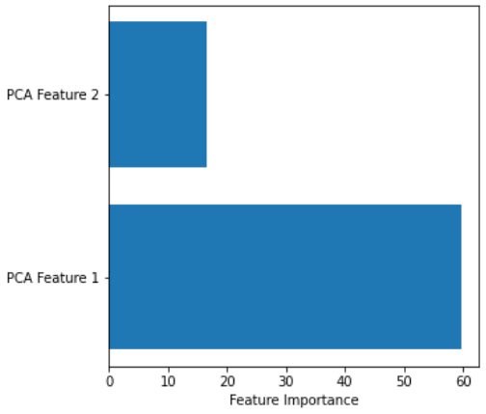
Visualization after PCA transform

Slide 13
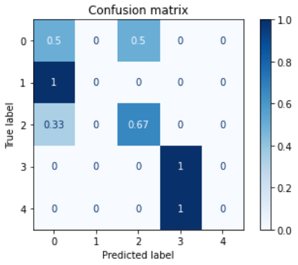
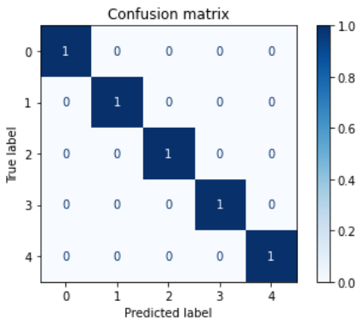
Classification Results
Using SVM with all the features
Using SVM with 2D PCA transformation

Slide 14
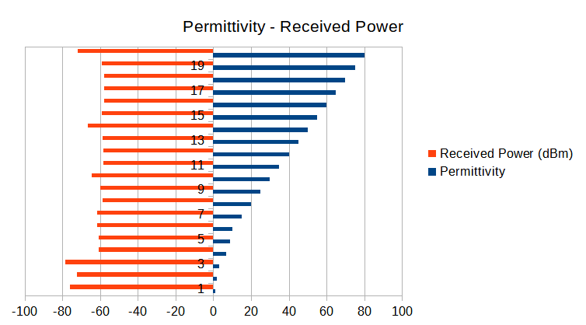
Beyond Classification to Material Properties
Next steps could be to create a dataset with varied material properties and then training a regressor to estimate those properties based on the reflected signals.
Due to time constraints, we could not create a detailed dataset such that a network can learn these parameters to regress permittivity values. But we have taken some steps towards it.

Slide 15
Thank you
Questions?

